Slide 1
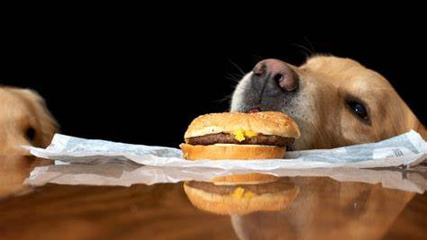
Healthy Eating: The Basics!

Slide 2
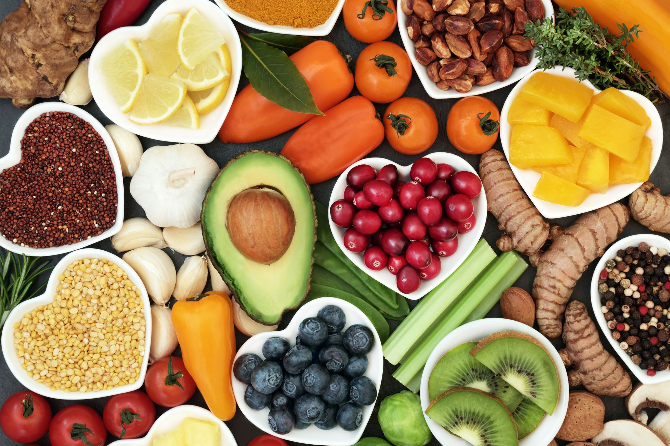
Lesson Objectives:
Recognize Why Eating Healthy Is Important
Categorize What Belongs To Which Food Groups
Comprehend What Calories Are And Where The Come From
To Interpret A Nutrition Facts Label

Slide 3
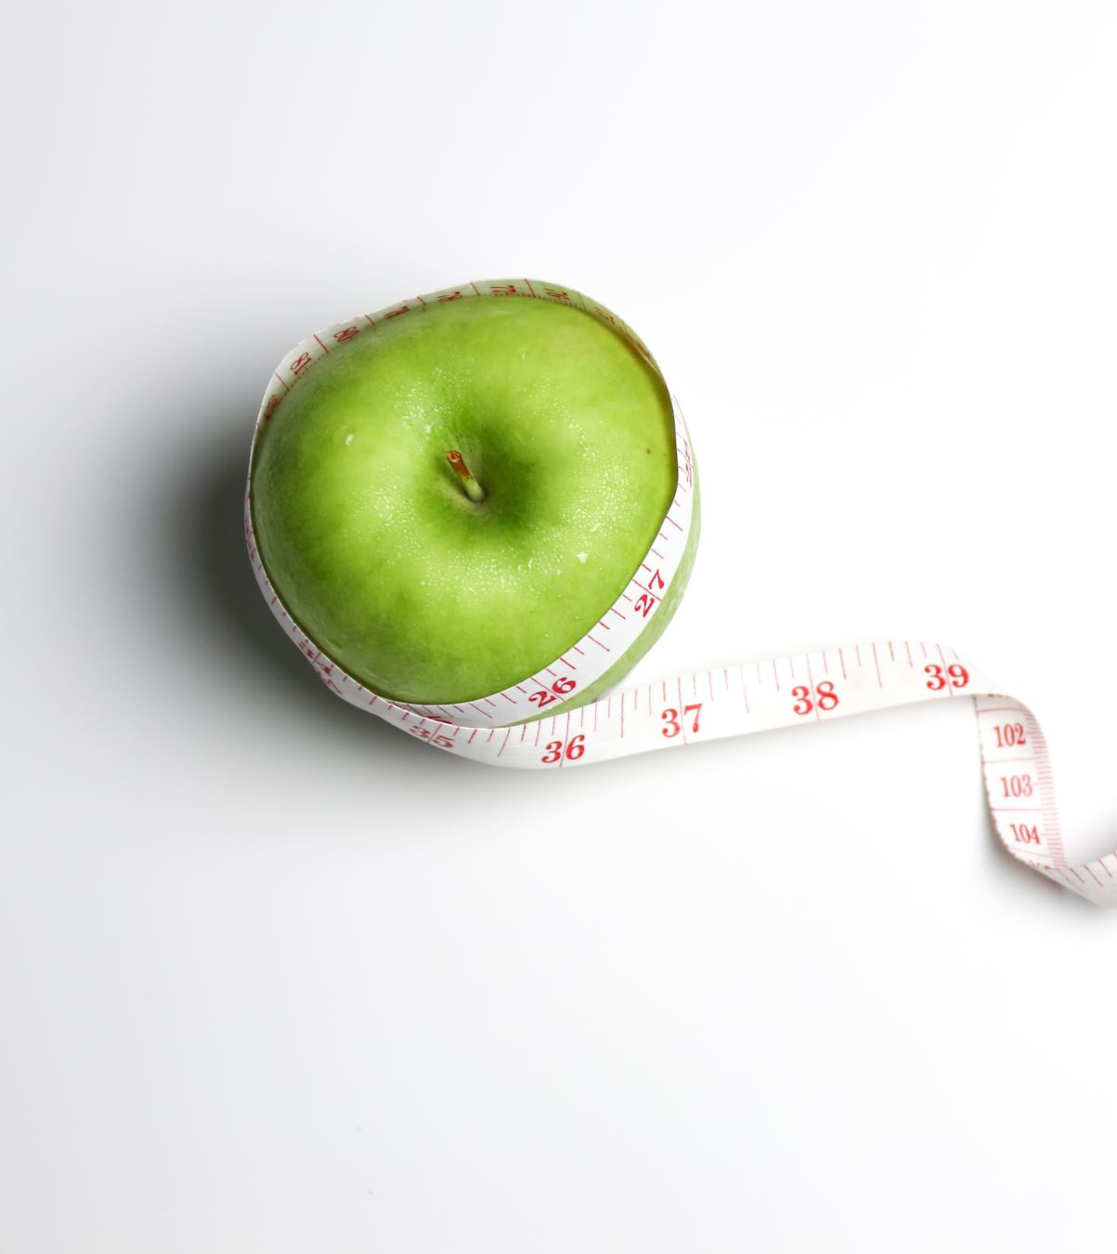
Why Eat Healthy?
Promotes Proper Cell Growth And Replication
  Lowers Fat Levels In The Body
  Supports Your Immune System
Elevates Your Mood (Dopamine/Happy Hormone)
Aids In Body Regulation (Homeostasis)

Slide 4

How Do I Eat Healthy?

Slide 5
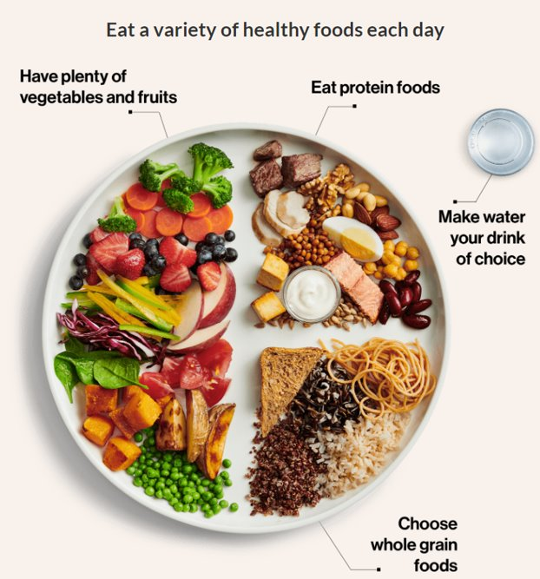
2019 Canada's Food Guide

Slide 6
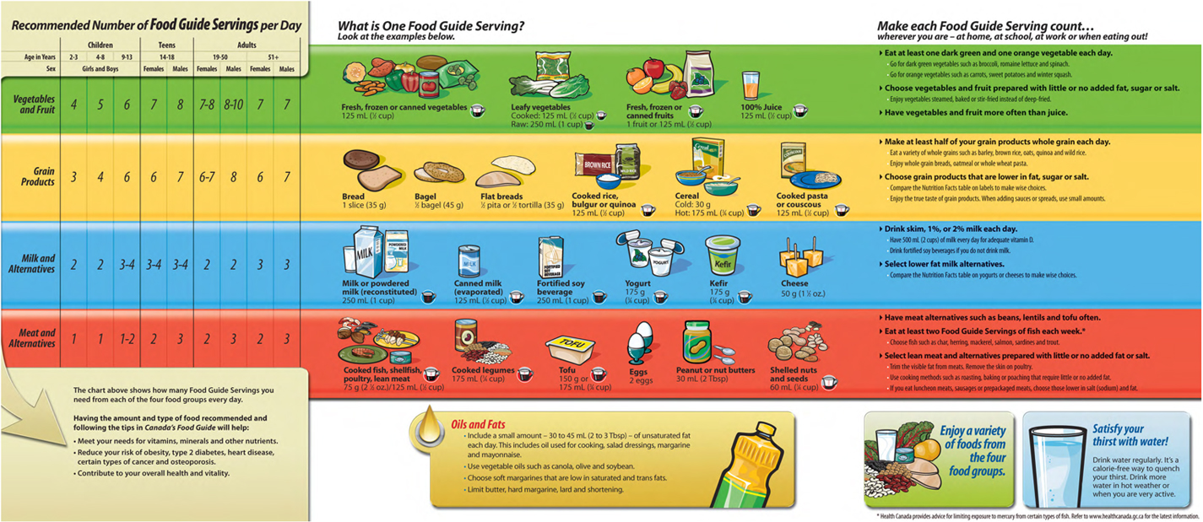
Canada's Food Guide 2007

Slide 7
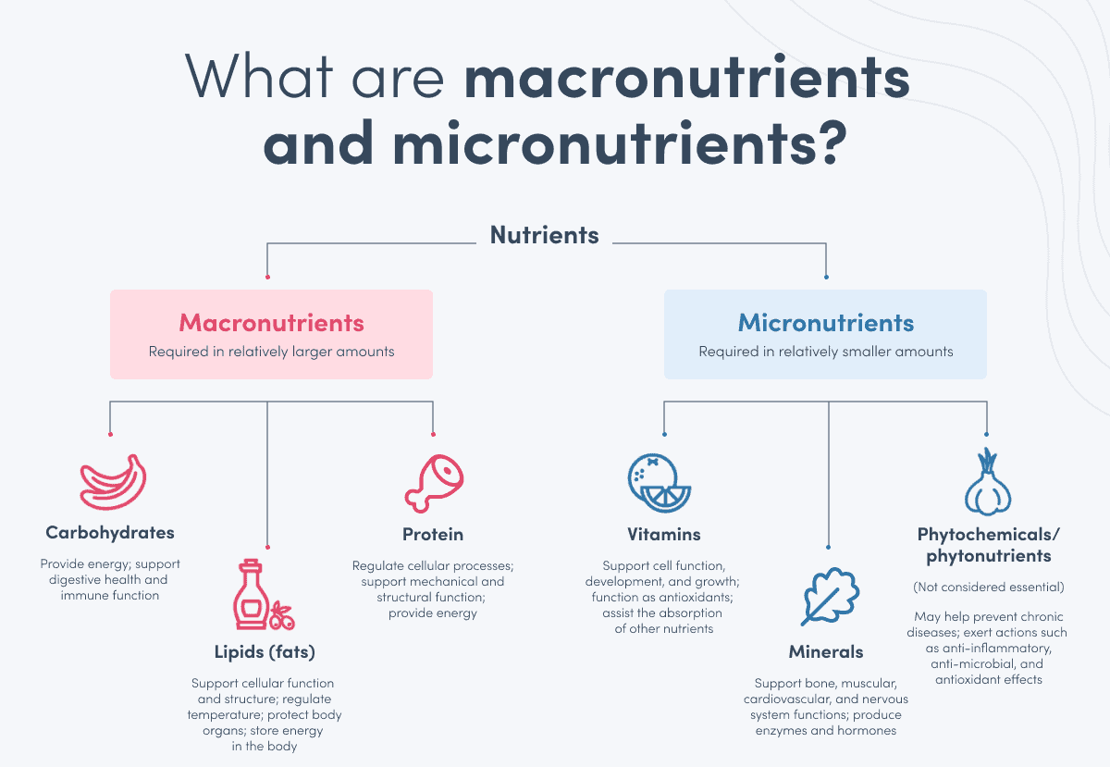


Slide 8

Egg Casserole Breakfast

Slide 9

Chicken Sheet Pan Dinner

Slide 10

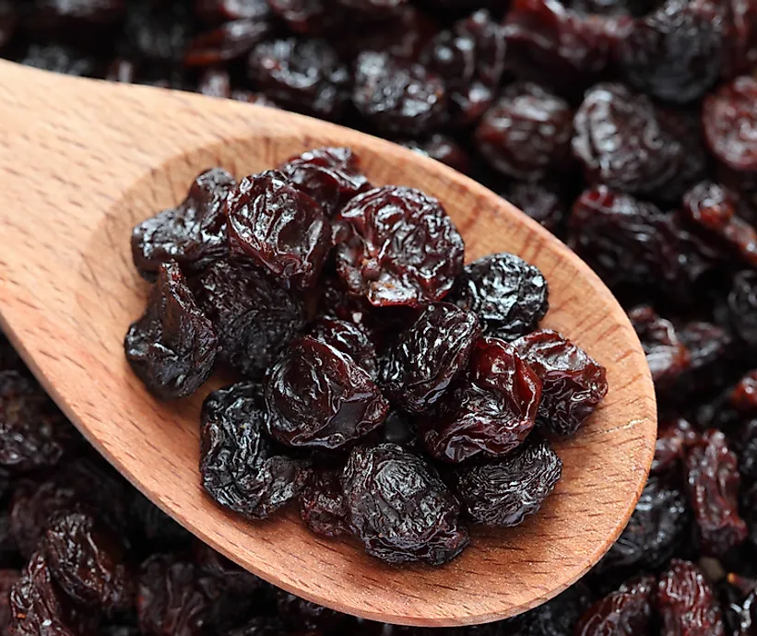
What Is A Calorie? And Will They Eat Me?
Calories =
Gram =

Slide 11
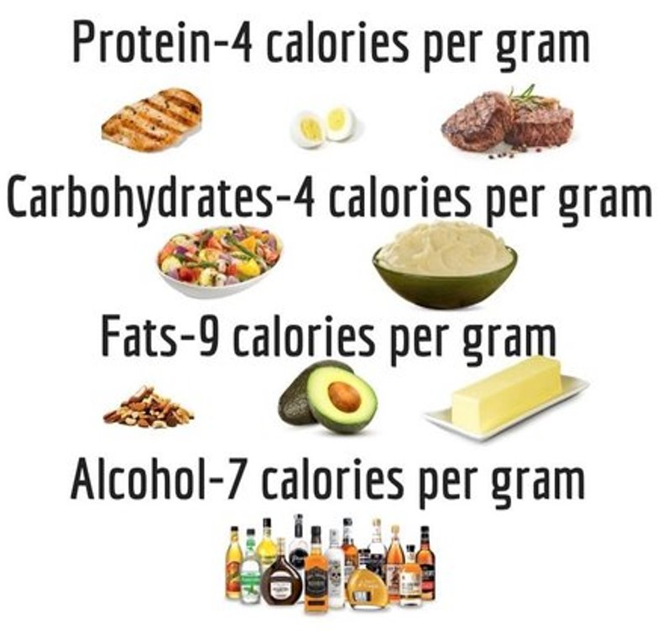

Roman... I Thought We Were Doing Healthy Eating Not Math

Slide 12


200g Of Chicken (Protein)
150g Of McDonald's Fries (Carbohydrates)

Slide 13
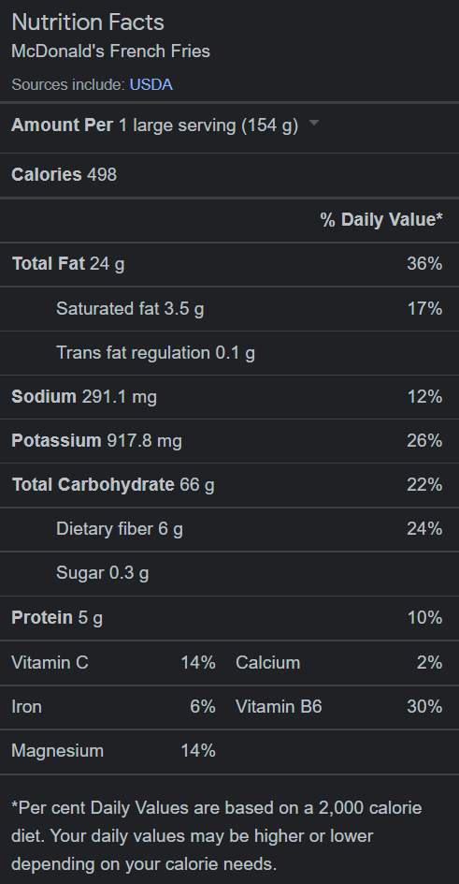
Nutrition Facts Labels

Slide 14
Where Does Weight Come From?
"Body Fat" Or "Fat" Is Just Excess Calories Our Body Stores
If You Eat 2500 Calories And Only Use 2000 Calories That Day
You Gained 500 Calories
55.6 Grams Of Fat

Slide 15

Roman, I Don't Want To Quit On The Foods I Love!
You Don't Have To!
If You Burn More Calories Than What You Intake, You Will Be Fine! (Coming To The YMCA)
HOWEVER, Proper Diets Like Canada's Food Guide Are Very Impactful

